Slide 1

What is hypothesis testing?
It is a statistical method used to make inferences or draw conclusions about a population based on sample data.
H₀: No difference/no effect
H₁: Alternative
We always consider H₀ as “true” which means we put our goal in this hypothesis. For example:
H₀: There is no difference between proportion of M and F for the gender variable
H₀: Error for the new model is equivalent to the base mode
Null hypothesis is called “no effect” or “no difference.” So, although we can define it differently, it is not recommended.
Hypothesis testing
P-value
R²
Pearson’s r (r²)
Chi-square
t-student
ANOVA
Esmaeil Rezaei
www.dataharnessing.com youtube.com/@dataharnessing
Notes:
http://modir-mba.com

Slide 2
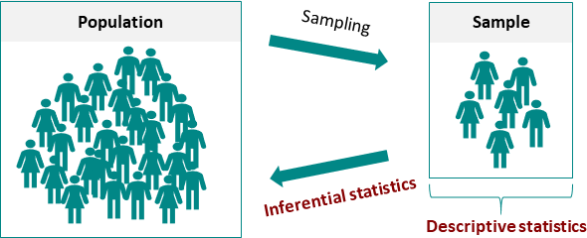

It is a statistical method used to make inferences or draw conclusions about a population based on sample data.
Hypothesis testing
Inferential Statistics: Consists of statistical methods used to test hypotheses related to the relationships between variables.
P-value
R²
Pearson’s r (r²)
Chi-square
Descriptive Statistics: Involves showing trends and patterns through plots like histograms, line charts, etc.
t-student
ANOVA
Esmaeil Rezaei
www.dataharnessing.com youtube.com/@dataharnessing
Notes:
http://modir-mba.com

Slide 3
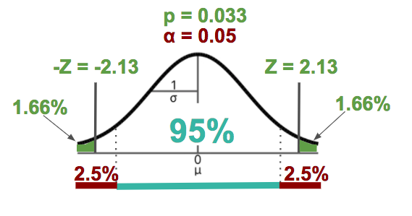
P-value:
It represents the probability of observing the data, or something more extreme, assuming that the null hypothesis (H₀) is true.
Critical value:
It represents the threshold or boundary that the test statistic must exceed to reject the null hypothesis.
Reference for this figure: statmagic.info
Hypothesis testing
P-value
R²
Pearson’s r (r²)
Chi-square
t-student
ANOVA
Esmaeil Rezaei
www.dataharnessing.com youtube.com/@dataharnessing
Notes:
http://modir-mba.com

Slide 4
sss
Hypothesis testing
P-value
R²
Pearson’s r (r²)
Chi-square
t-student
ANOVA
Esmaeil Rezaei
www.dataharnessing.com youtube.com/@dataharnessing
Notes:
http://modir-mba.com

Slide 5
sss
Hypothesis testing
P-value
R²
Pearson’s r (r²)
Chi-square
t-student
ANOVA
Esmaeil Rezaei
www.dataharnessing.com youtube.com/@dataharnessing
Notes:
http://modir-mba.com

Slide 6
sss
Hypothesis testing
P-value
R²
Pearson’s r (r²)
Chi-square
t-student
ANOVA
Esmaeil Rezaei
www.dataharnessing.com youtube.com/@dataharnessing
Notes:
http://modir-mba.com

Slide 7
sss
Hypothesis testing
P-value
R²
Pearson’s r (r²)
Chi-square
t-student
ANOVA
Esmaeil Rezaei
www.dataharnessing.com youtube.com/@dataharnessing
Notes:
http://modir-mba.com

Slide 8
sss
Hypothesis testing
P-value
R²
Pearson’s r (r²)
Chi-square
t-student
ANOVA
Esmaeil Rezaei
www.dataharnessing.com youtube.com/@dataharnessing
Notes:
http://modir-mba.com

